Slide 1
Coffee Shop Sales Analysis
Pavan M R

Slide 2
index
About Company
Introduction
Software Requirements
Methodology
Result
Conclusion

Slide 3
About Company
Empowering Futures through Knowledge
Utilizing Most Effective Training Methods
Developing Tomorrow's Tech Leaders
uiding Excellence with Unified Mentorship

Slide 4
Introduction
In this project, we aim to analyze and uncover insights from sales data at a coffee shop using data science techniques. The dataset contains several columns that record essential details about each transaction.
date
datetime
cash_type
card
money
coffee_name
Quantity
Sales

Slide 5
Requirements
Hardware Requirements
Processor: 2.4 GHz processor
Main Memory: 1 GB
Ram: 1.00GB
Hard Disk: 240 GHz
Software Requirements
Operating System: Windows
MS Excel, SQL, Python

Slide 6
Methodology
Data Collection
Data Preprocessing
Exploratory Data Analysis (EDA)
Data Visualization
Statistical Analysis
Machine Learning Models

Slide 7
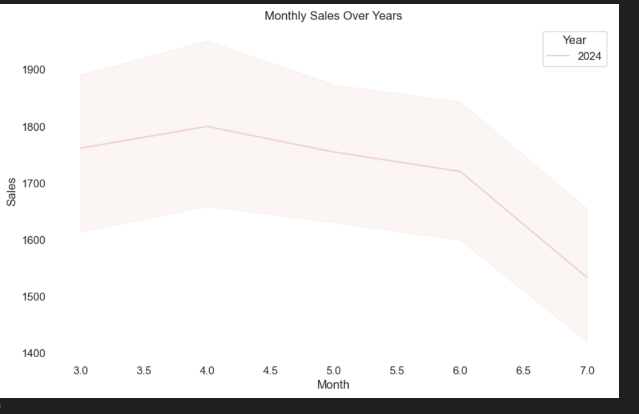
Result

Slide 8
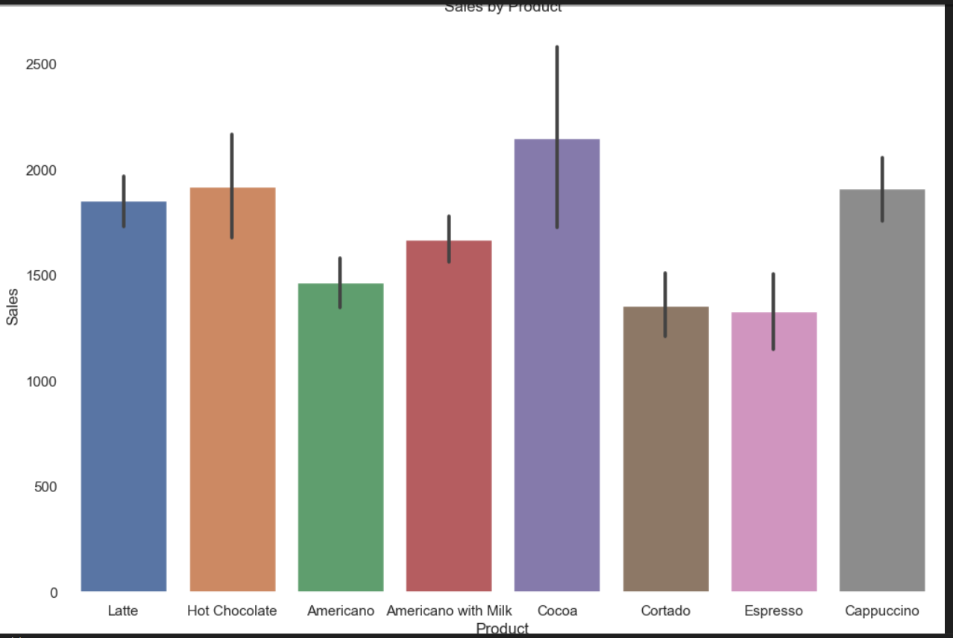

Slide 9
Conclusion
In conclusion, the analysis of the coffee shop’s sales data provided valuable insights into customer preferences, sales trends, and payment methods. Popular coffee items were identified, enabling better inventory management and menu optimization, while time-based sales patterns revealed opportunities to adjust staffing during peak hours. The analysis also highlighted the growing preference for cashless transactions, suggesting improvements in payment processes. Overall, these insights can guide strategic decisions to enhance customer satisfaction, optimize operations, and drive increased revenue. By leveraging data-driven strategies, the coffee shop can ensure sustained growth and efficiency.

Slide 10
Thank you

